Slide 1
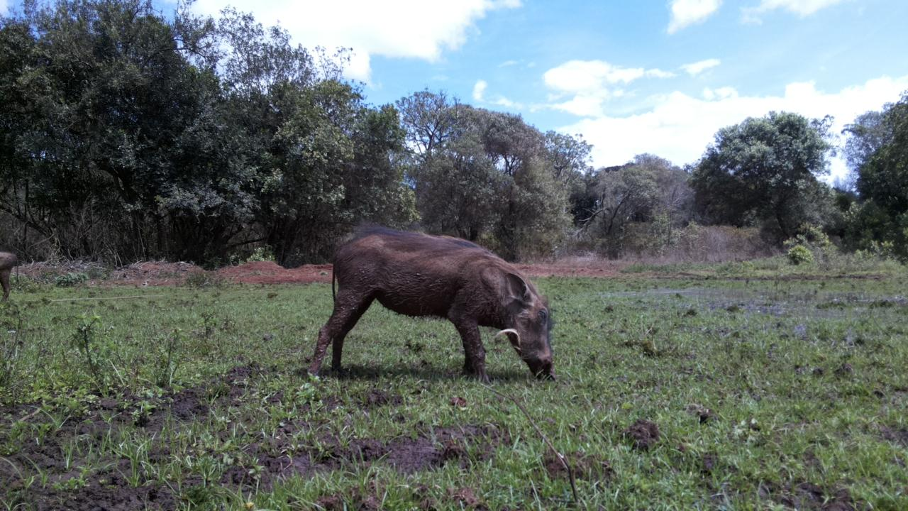
DSAIL-Porini: Annotated camera trap images of wildlife species from a conservancy in Kenya
Lorna Mugambi
Centre for Data Science and Artificial Intelligence (DSAIL)

Slide 2
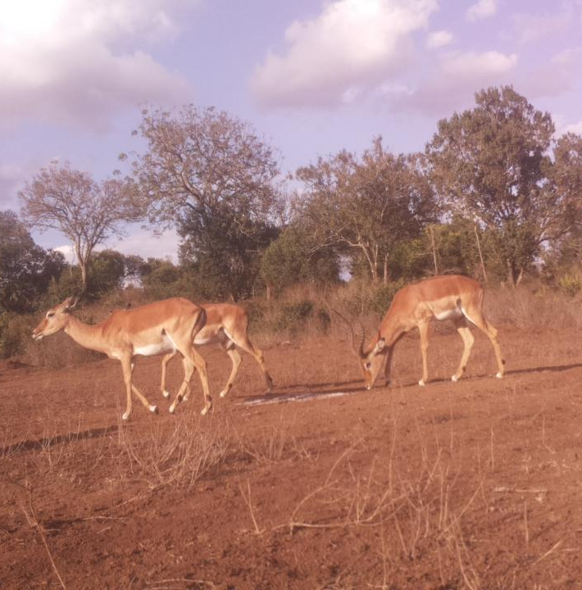
Introduction
Camera traps record accurate data in a non-invasive way
These data can be reviewed/used by other researchers.
Census, Sex distribution, feeding habits.
Replaced traditional techniques - release & capture
Deployed 4 camera traps for 7 months; from June 2021 to December 2021

Slide 3
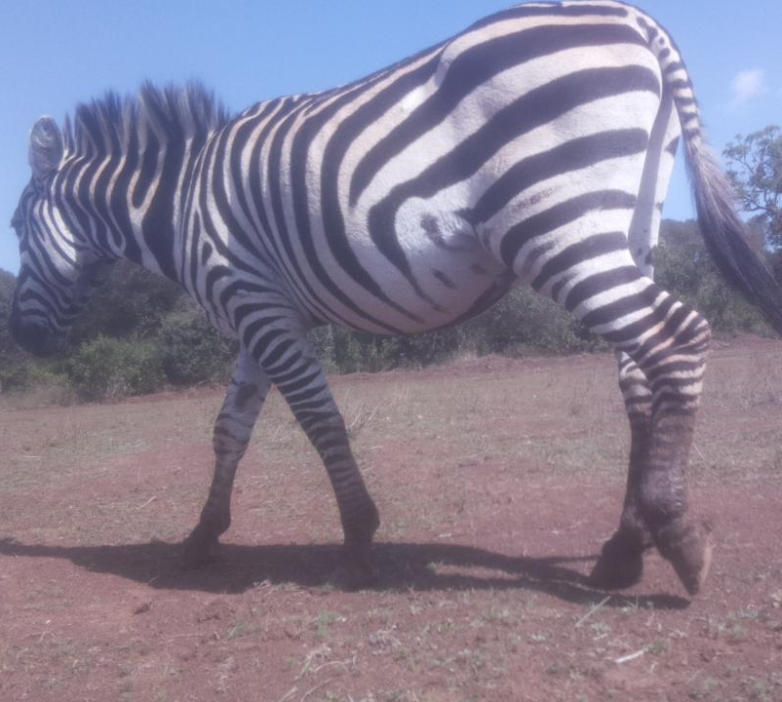
DSAIL-Porini Dataset
8524 annotated images of animals
The dataset has 6 categories;
Impala
Common warthog
Burchell’s zebra
Sykes’ monkey
Defassa waterbuck
Bushbuck.
8254 images from the Raspberry Pi 2 and 610 from the Pi zero
325 images from the Open mv
All the images are in JPG format

Slide 4
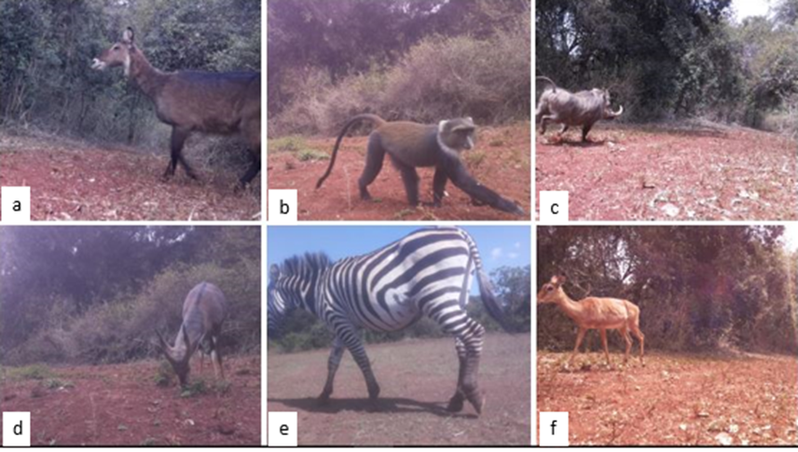
Species in the conservancy

Slide 5
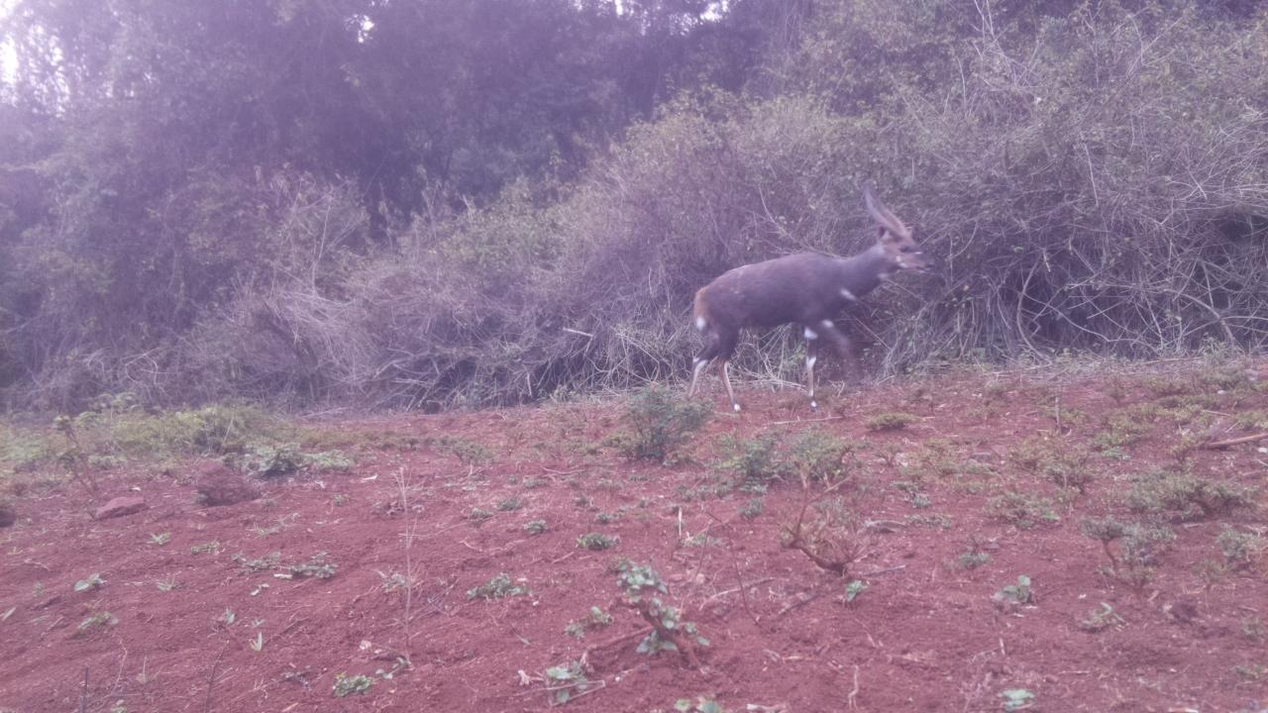
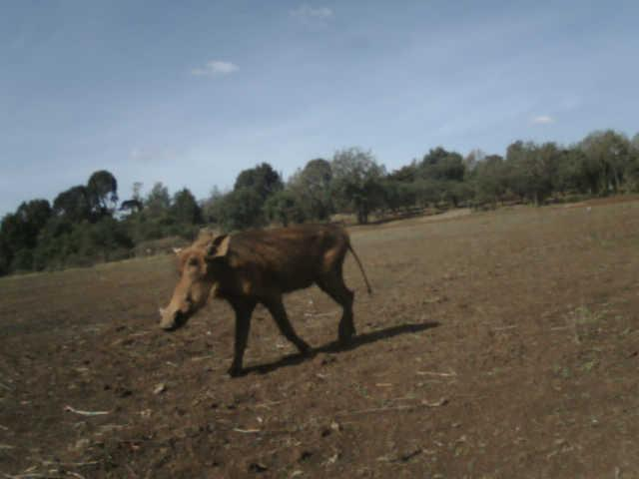
Value of the Data
Train machine learning models for classification and Object detection
Train and test image-based census algorithms as it includes animal counts,
Understand animal behaviour
Estimate the animal population growth with time

Slide 6
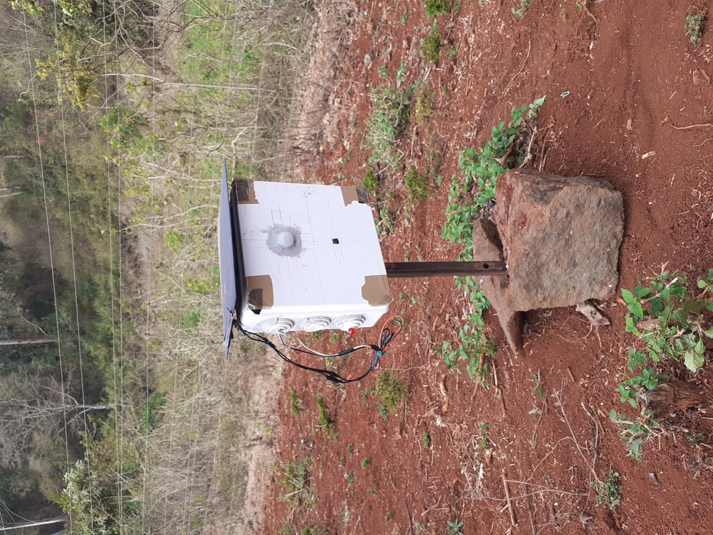
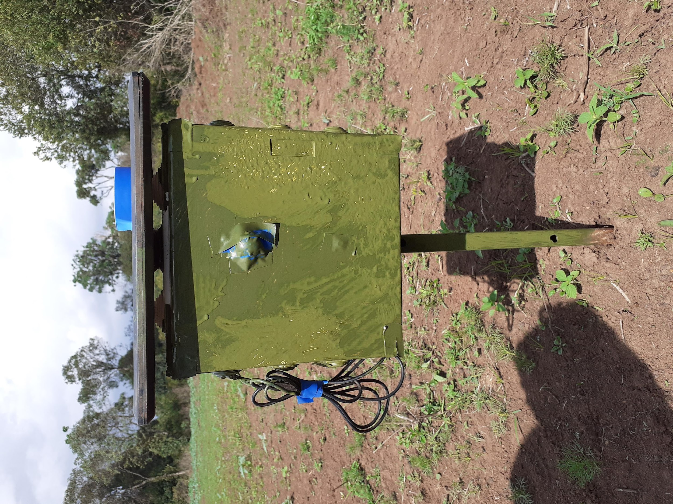
Deployment
We painted the camera traps green to camouflage them.
We got more close ups of animals like the waterbuck.

Slide 7
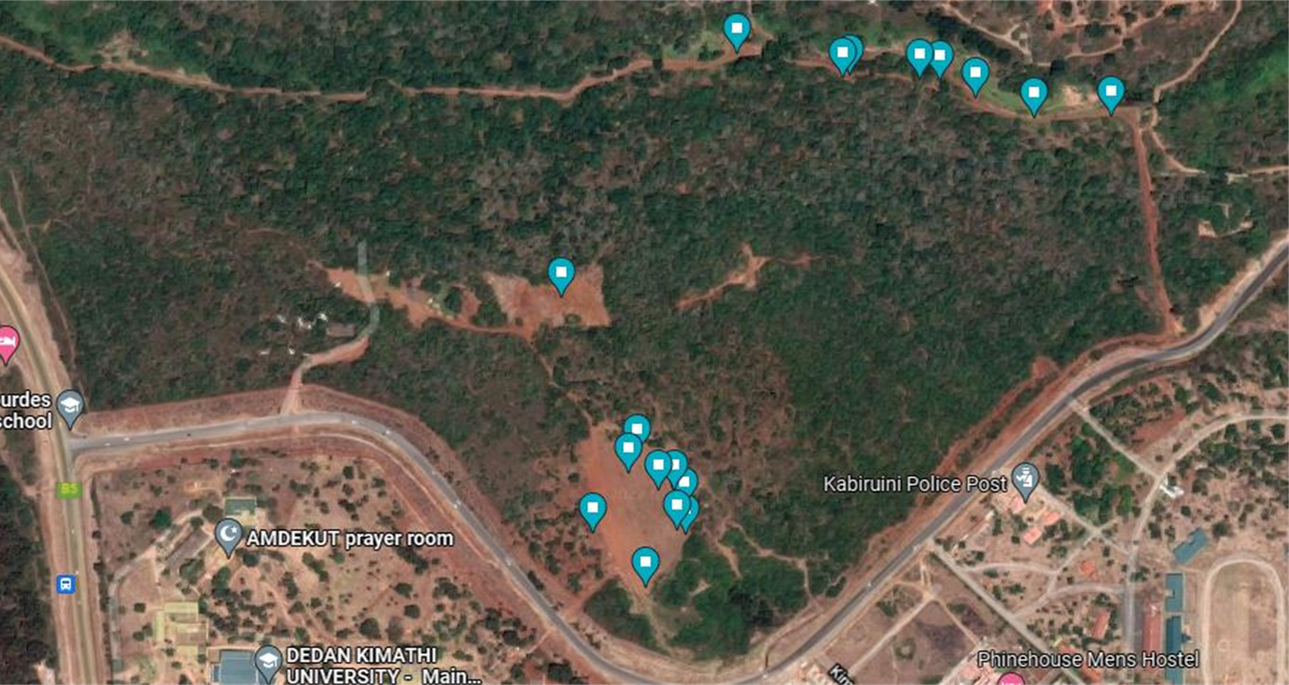
Camera trap placement
The decision to place the camera traps in these locations was based on;
1. Locations where mineral supplements were provided for the animals
2. Trails that led to water holes in the conservancy and areas near the waterholes
3. Any other place where water would be provided by the wardens.

Slide 8
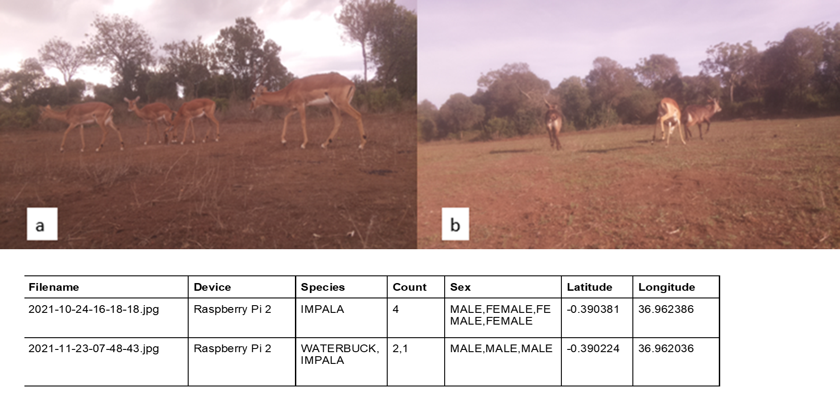
Data Annotation

Slide 9
Challenges during data annotation
Lens flare: This degraded the quality of some images
Overlapping animals in an image
The body of the animal being in the image partially
The process was time-consuming
At times, the images were captured when the animals were too far away. It was hard to tell which animals were captured especially when the grass had grown too long.
Telling the sex of animals like the zebras, warthogs and monkeys

Slide 10
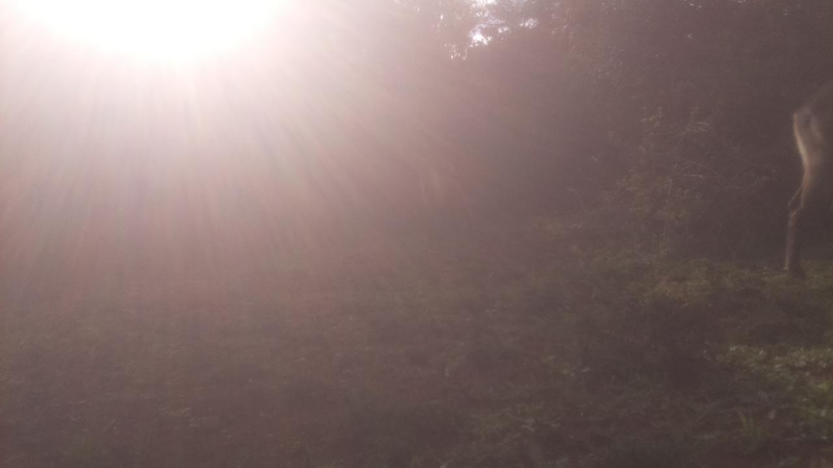
Lens flare

Slide 11
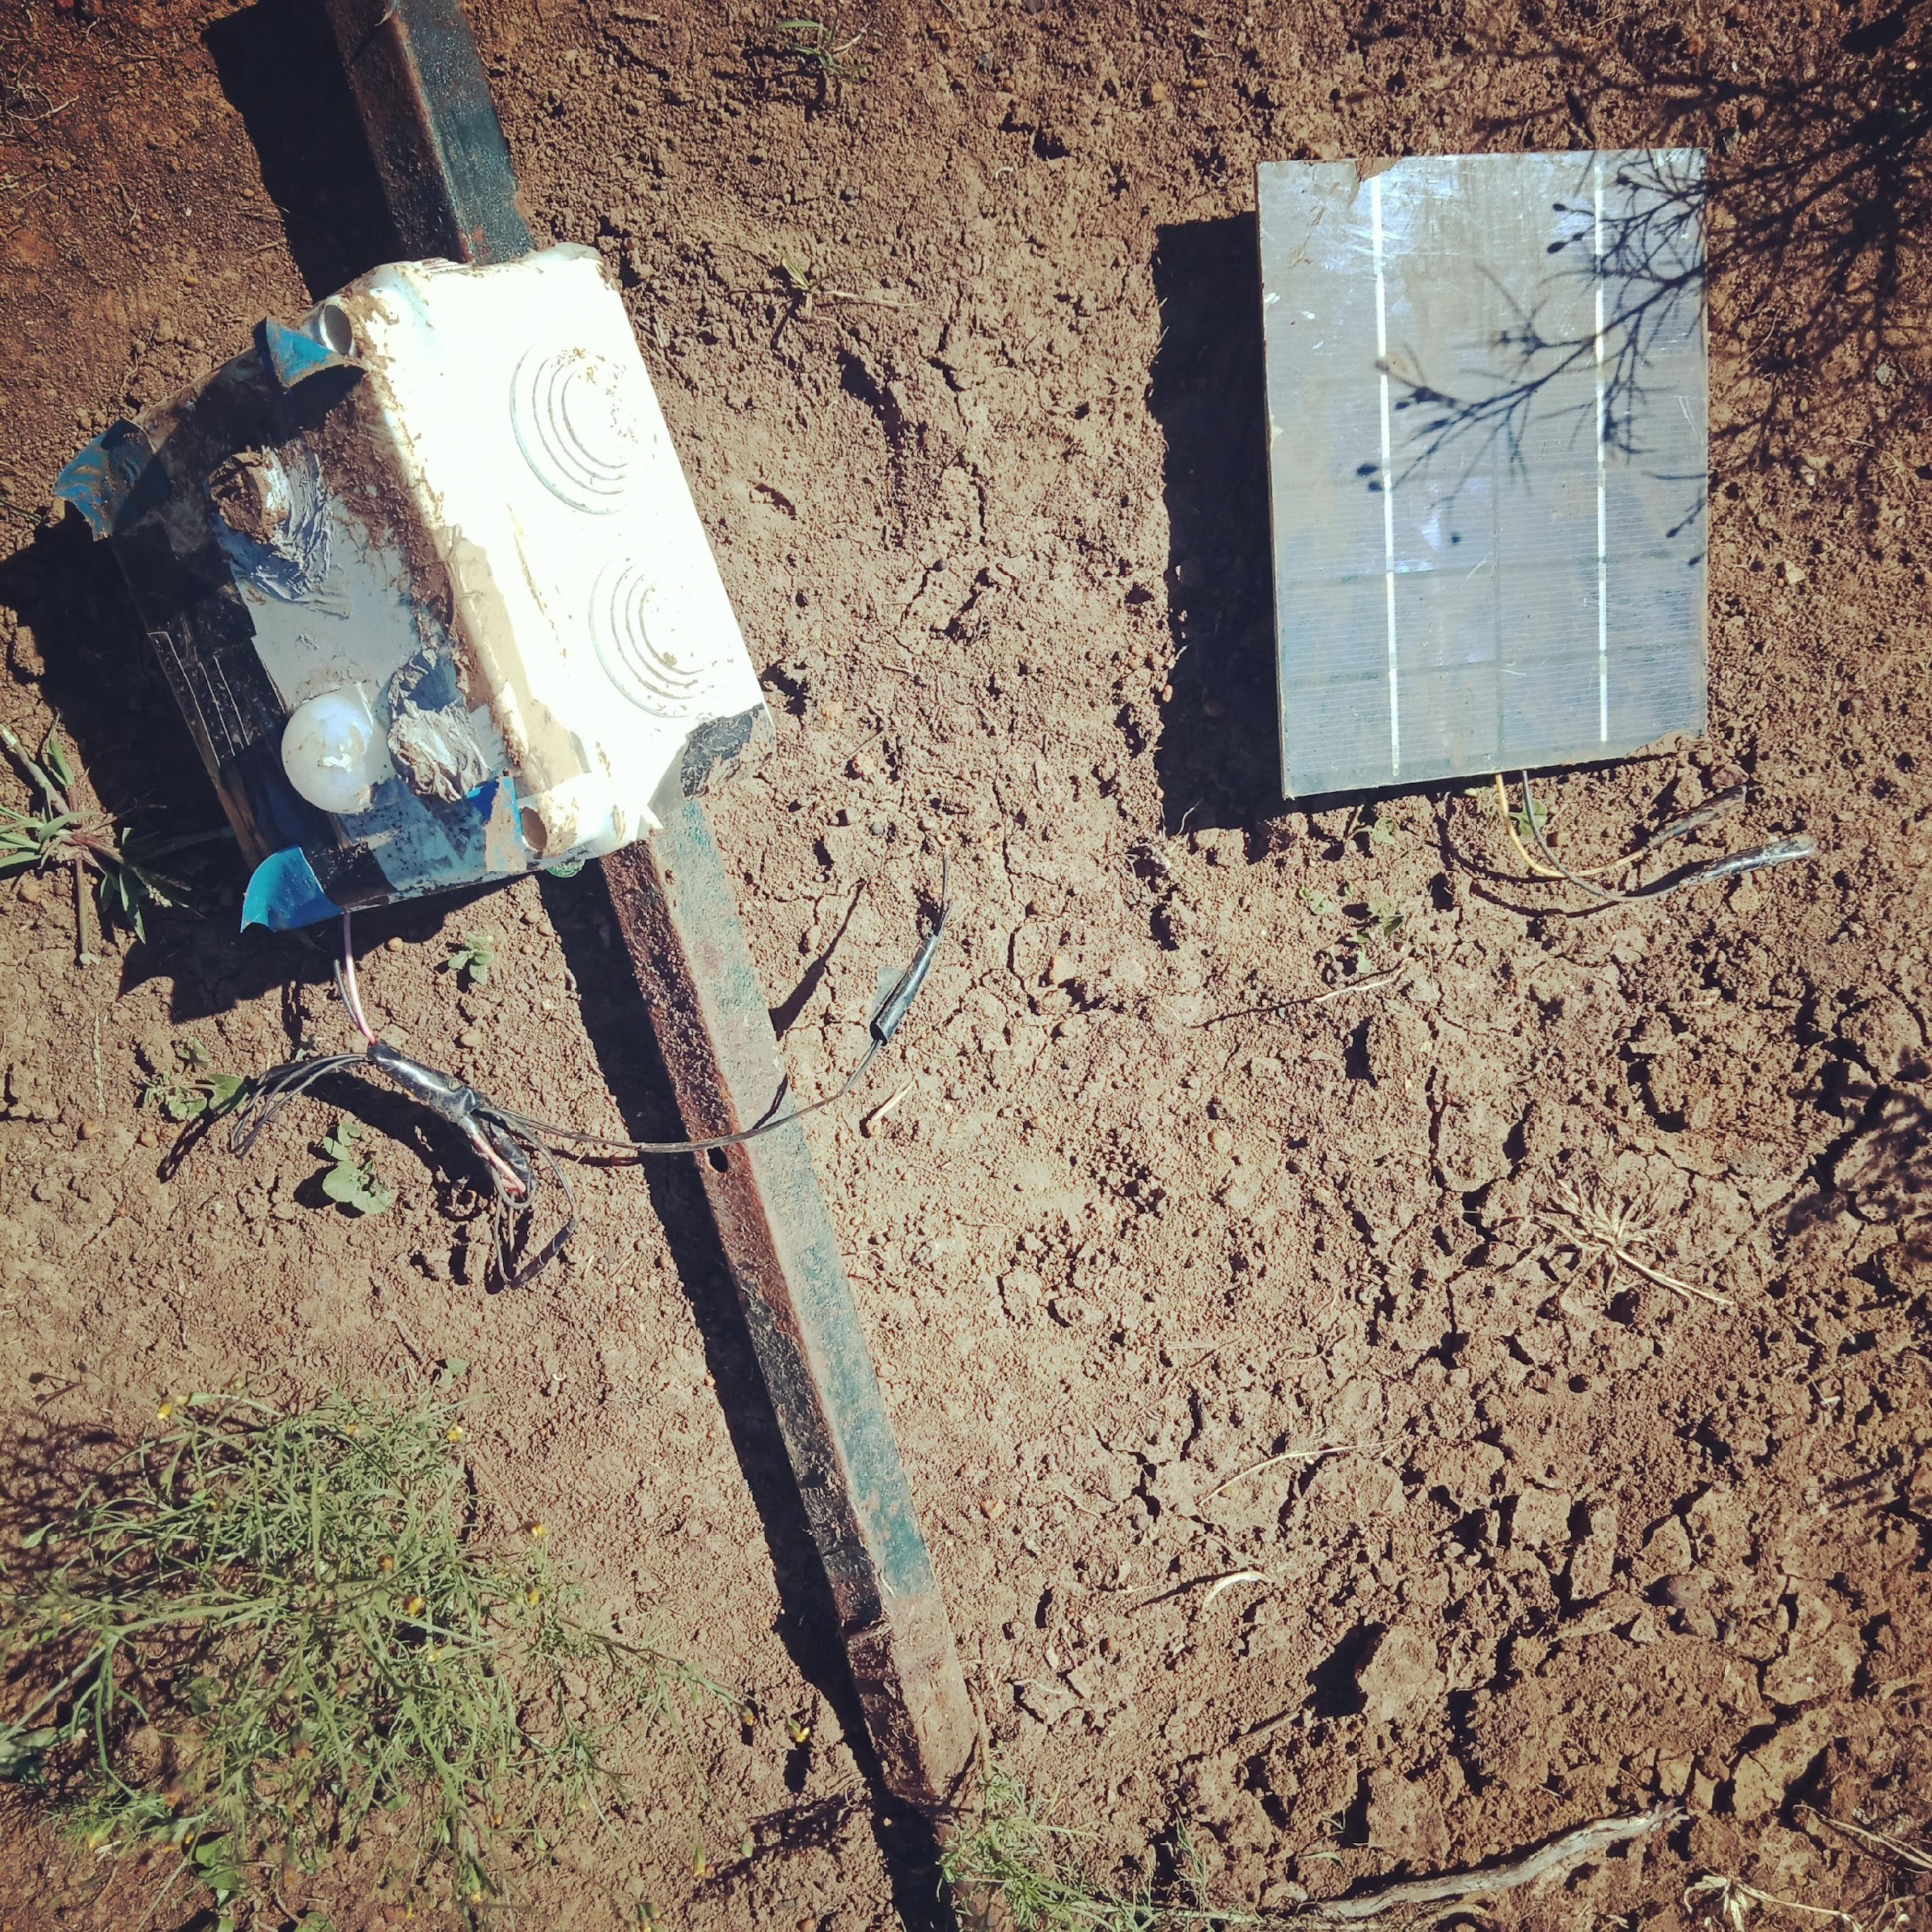
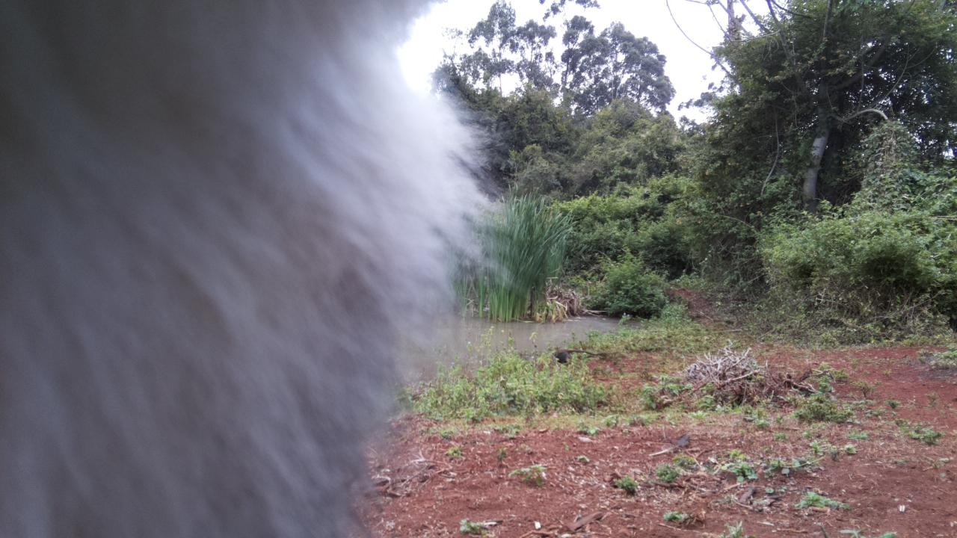

Slide 12
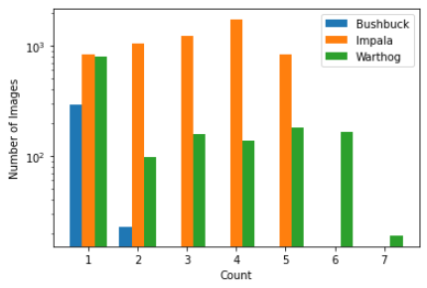
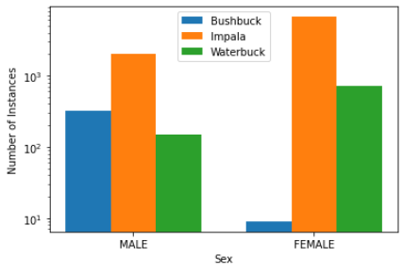
Data analysis
COUNT DISTRIBUTION
SEX DISTRIBUTION

Slide 13
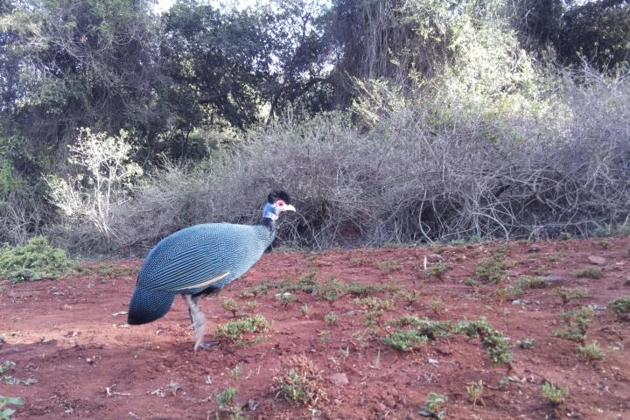
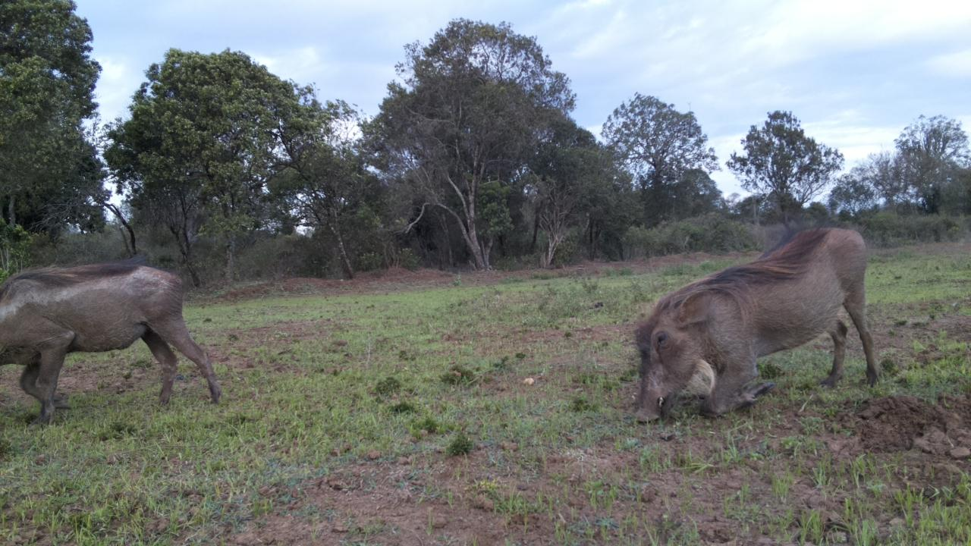
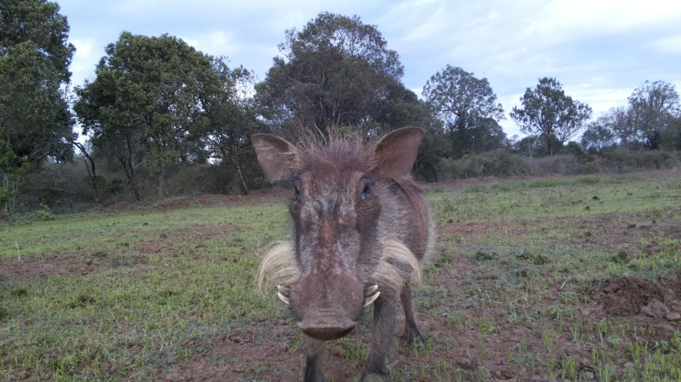

Slide 14
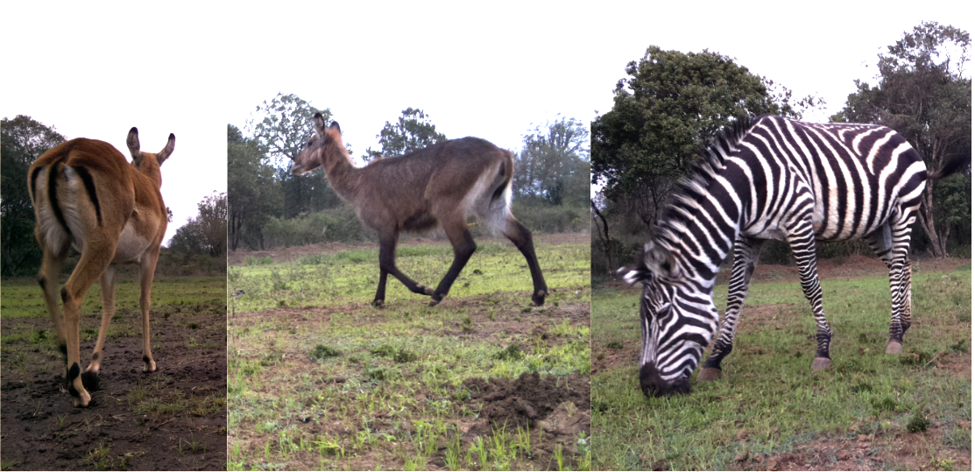

Slide 15
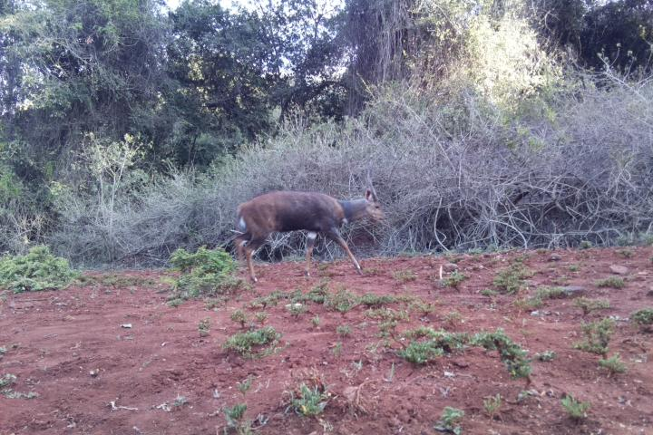
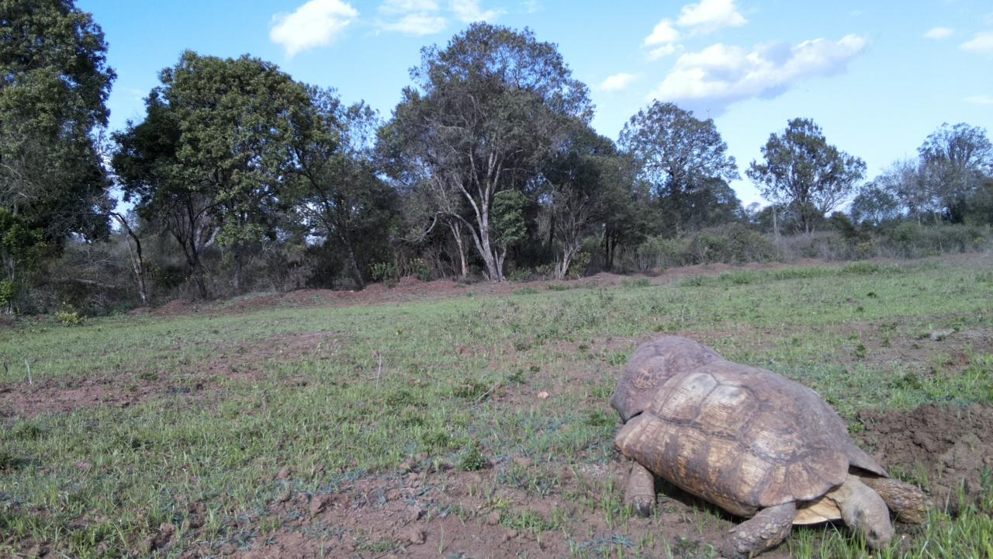

Slide 16
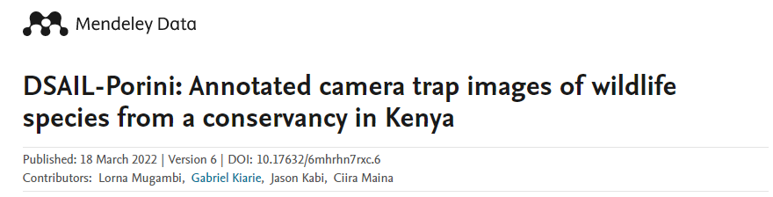



lorna.mugambi@dkut.ac.ke
THANK YOU

